Slide 1

Online Controlled Experiments: Listening to the Customers, not to the HiPPO
EC’10 6/11/2011
Ronny Kohavi, General Manager
Experimentation Platform, Microsoft ronnyk@microsoft
Notes:
http://sdforum.com/

Slide 2
EC’10 Cambridge Introduction
I have three key lessons to share. We’ll first do a Cambridge version of them.
You’re responsible for operations of the traffic lights in Cambridge, and there’s one intersection where there are always problems with the light
Do you
A - Send an engineer to find the root cause, which is estimated to take a few days
B – Put up a sign with a phone number to call when the lights don’t work

Slide 3
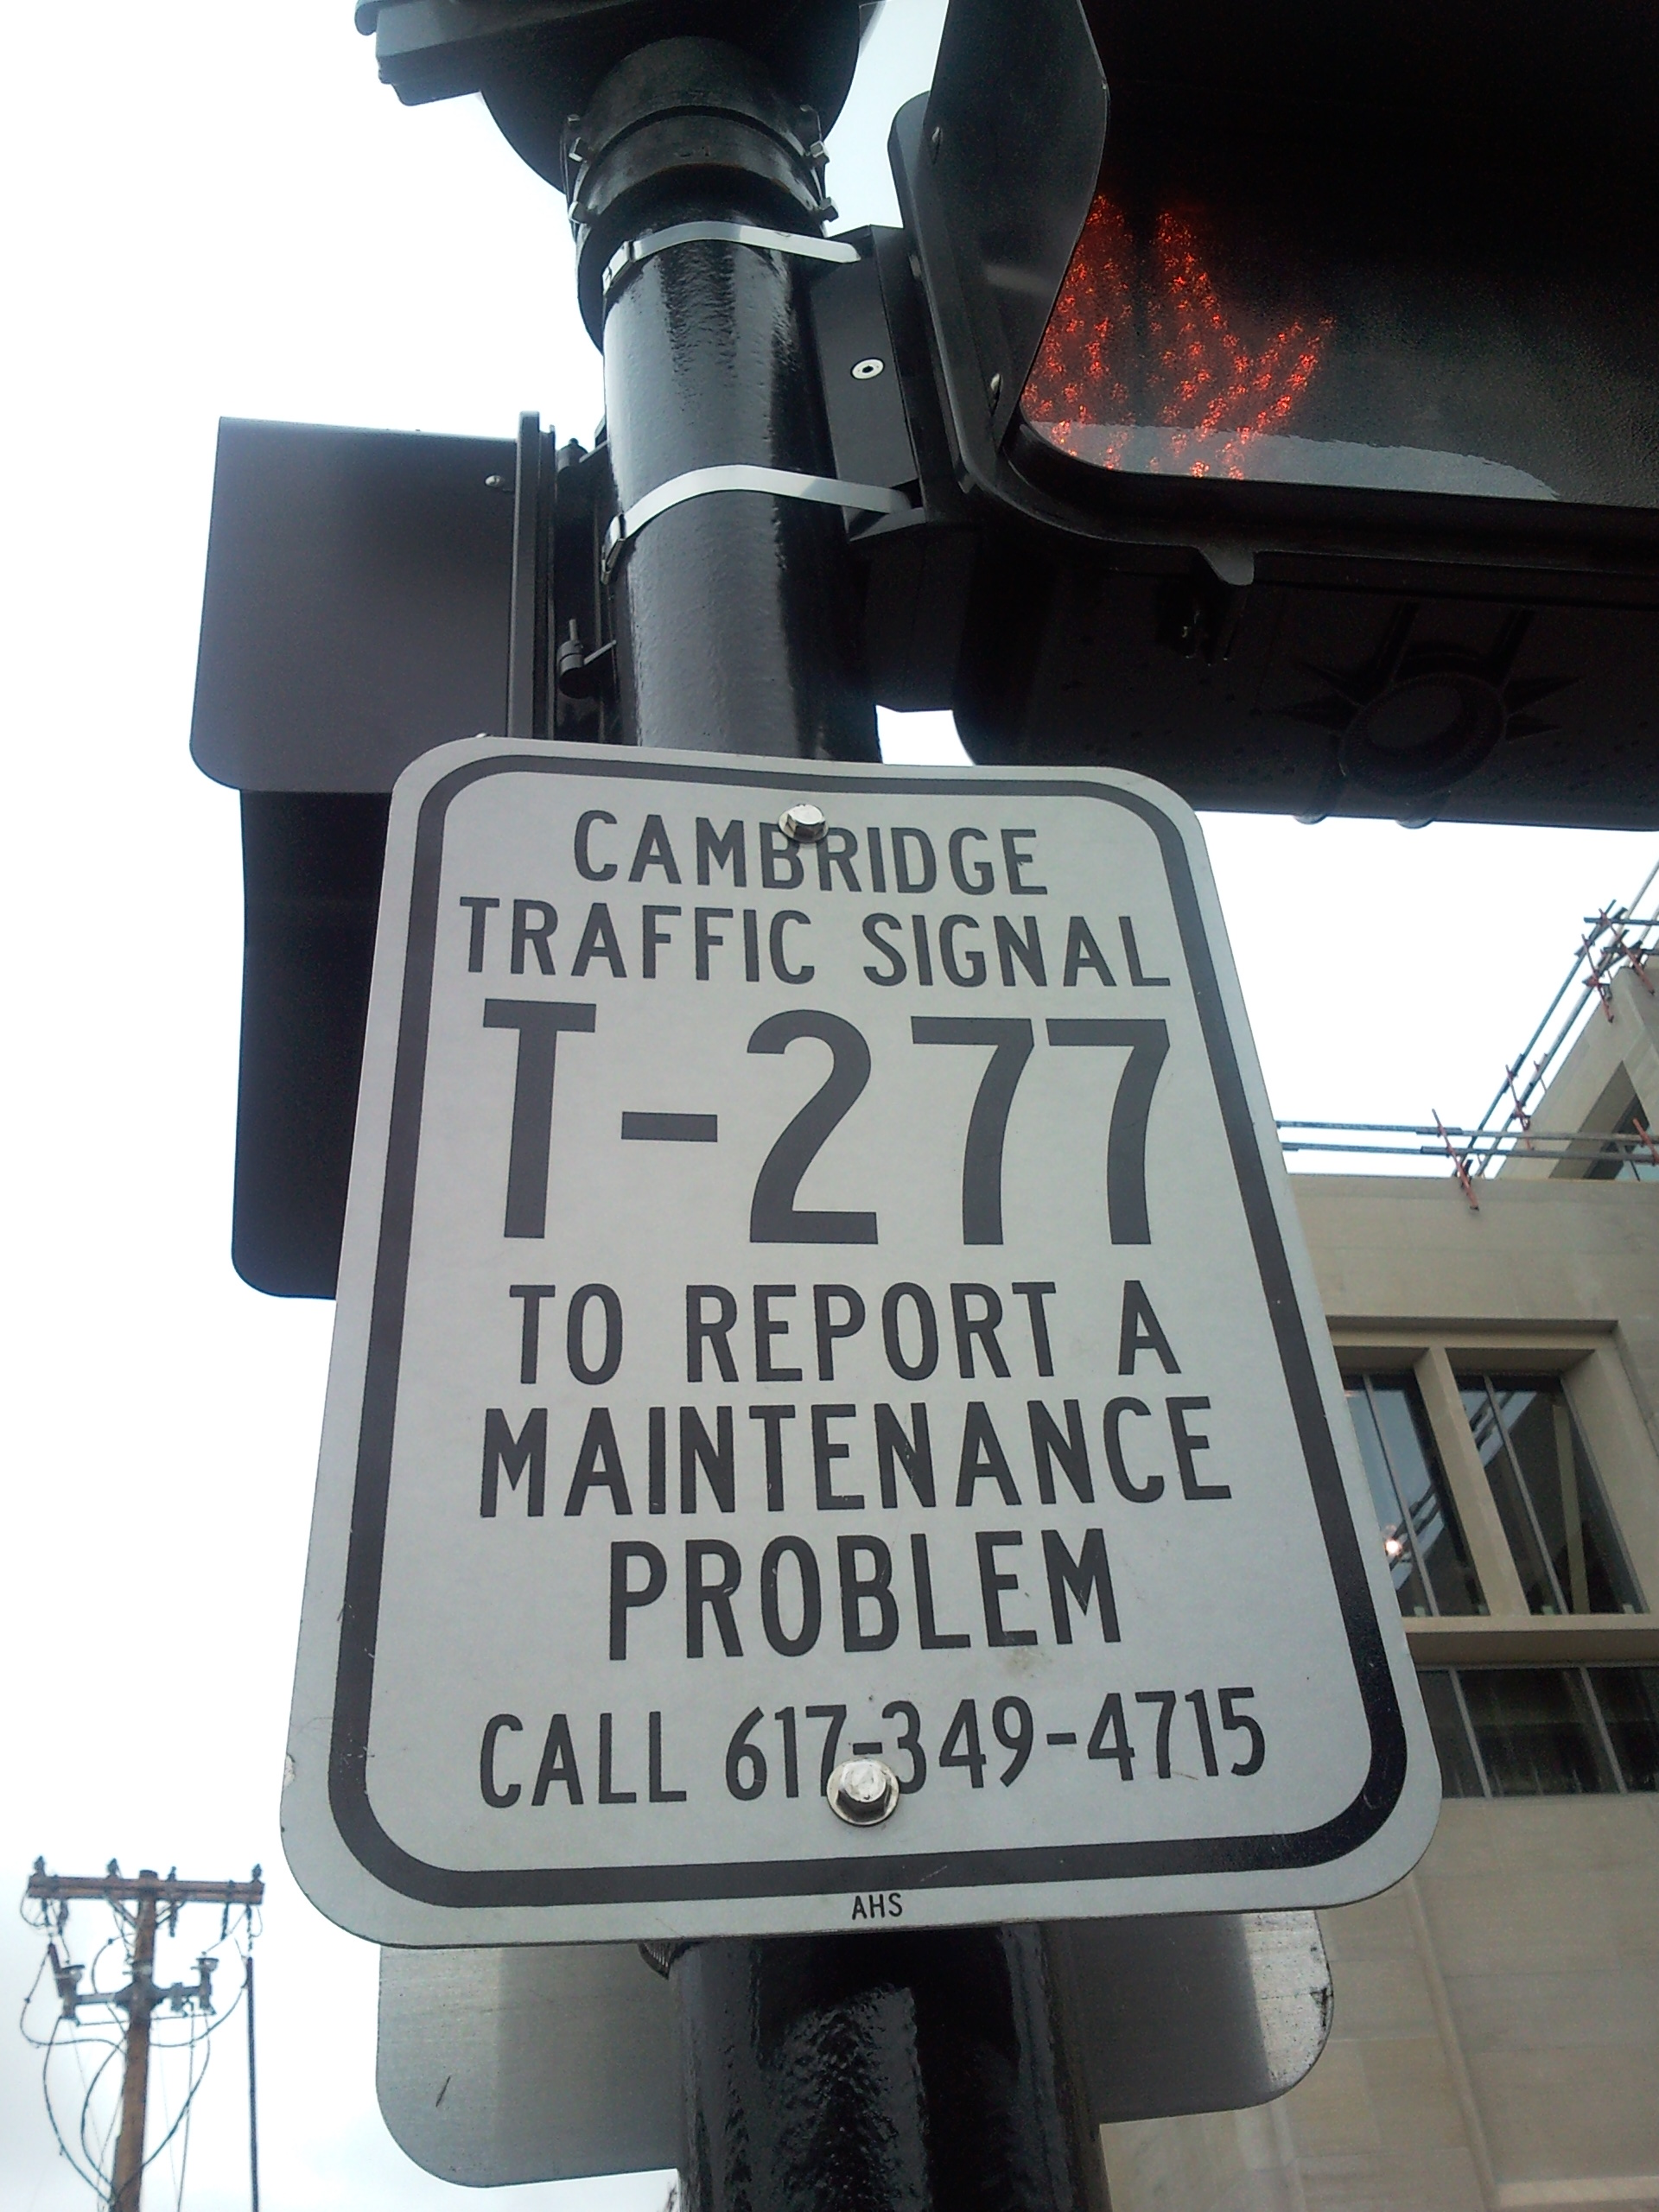
Traffic Lights
Key lesson in this talk: it depends on your OEC, the Overall Evaluation Criterion, or what you’re optimizing for
Good OEC: Uptime (% of time light is properly operating)
The twist: what’s the time horizon? Are you optimizing for uptime this week, or for the next year?
In Cambridge, it’s B – put up a sign
A retailer like Amazon should optimize for long-term customer lifetime value, not short term revenue. Picking a good OEC is key

Slide 4
Local Example 2: Cruise
You’re planning a conference that takes place in June
There’s a dinner cruise planned
Do you run the conference in
A: Seattle, WA
B: Cambridge, MA
Both have good waterfronts and boats

Slide 5
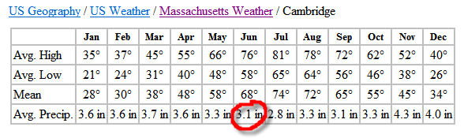
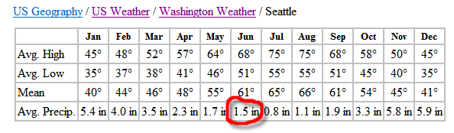
Cruise 2
What should you ask first?
What’s the OEC, the Overall Evaluation Criterion
The OEC can have multiple terms, but let’s focus on rain. We want to minimize the probability that it will rain during the cruise
What do you do?
Lesson #2: GET THE DATA
Cambridge gets over double the rainfall in June
Notes:
Even on a yearly average, Cambridge has more rainfall than Seattle (3.5” vs. 3.1”^{(*)})
(*) approximated by averaging the above months

Slide 6
Final Local Example
You’re responsible for programming the Sheraton Commander elevators here in the Cambridge
Scenario:
Both elevators are at the Lobby floor, doors closed
Someone comes in from the Lobby and hits the “up” button
Do you program the elevators to
A – Open the left elevator’s door
B – Open the right elevator’s door
C – Open both doors

Slide 7
Sheraton Elevators
First question you should ask?
What’s the OEC
Answer: mean time to get customer to their floor
Now what?
Lesson #2: Get the data!
Anyone staying at the conference hotel that knows the critical data?

Slide 8
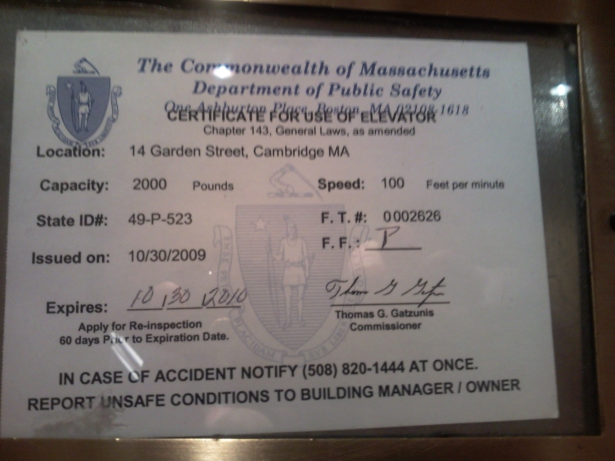
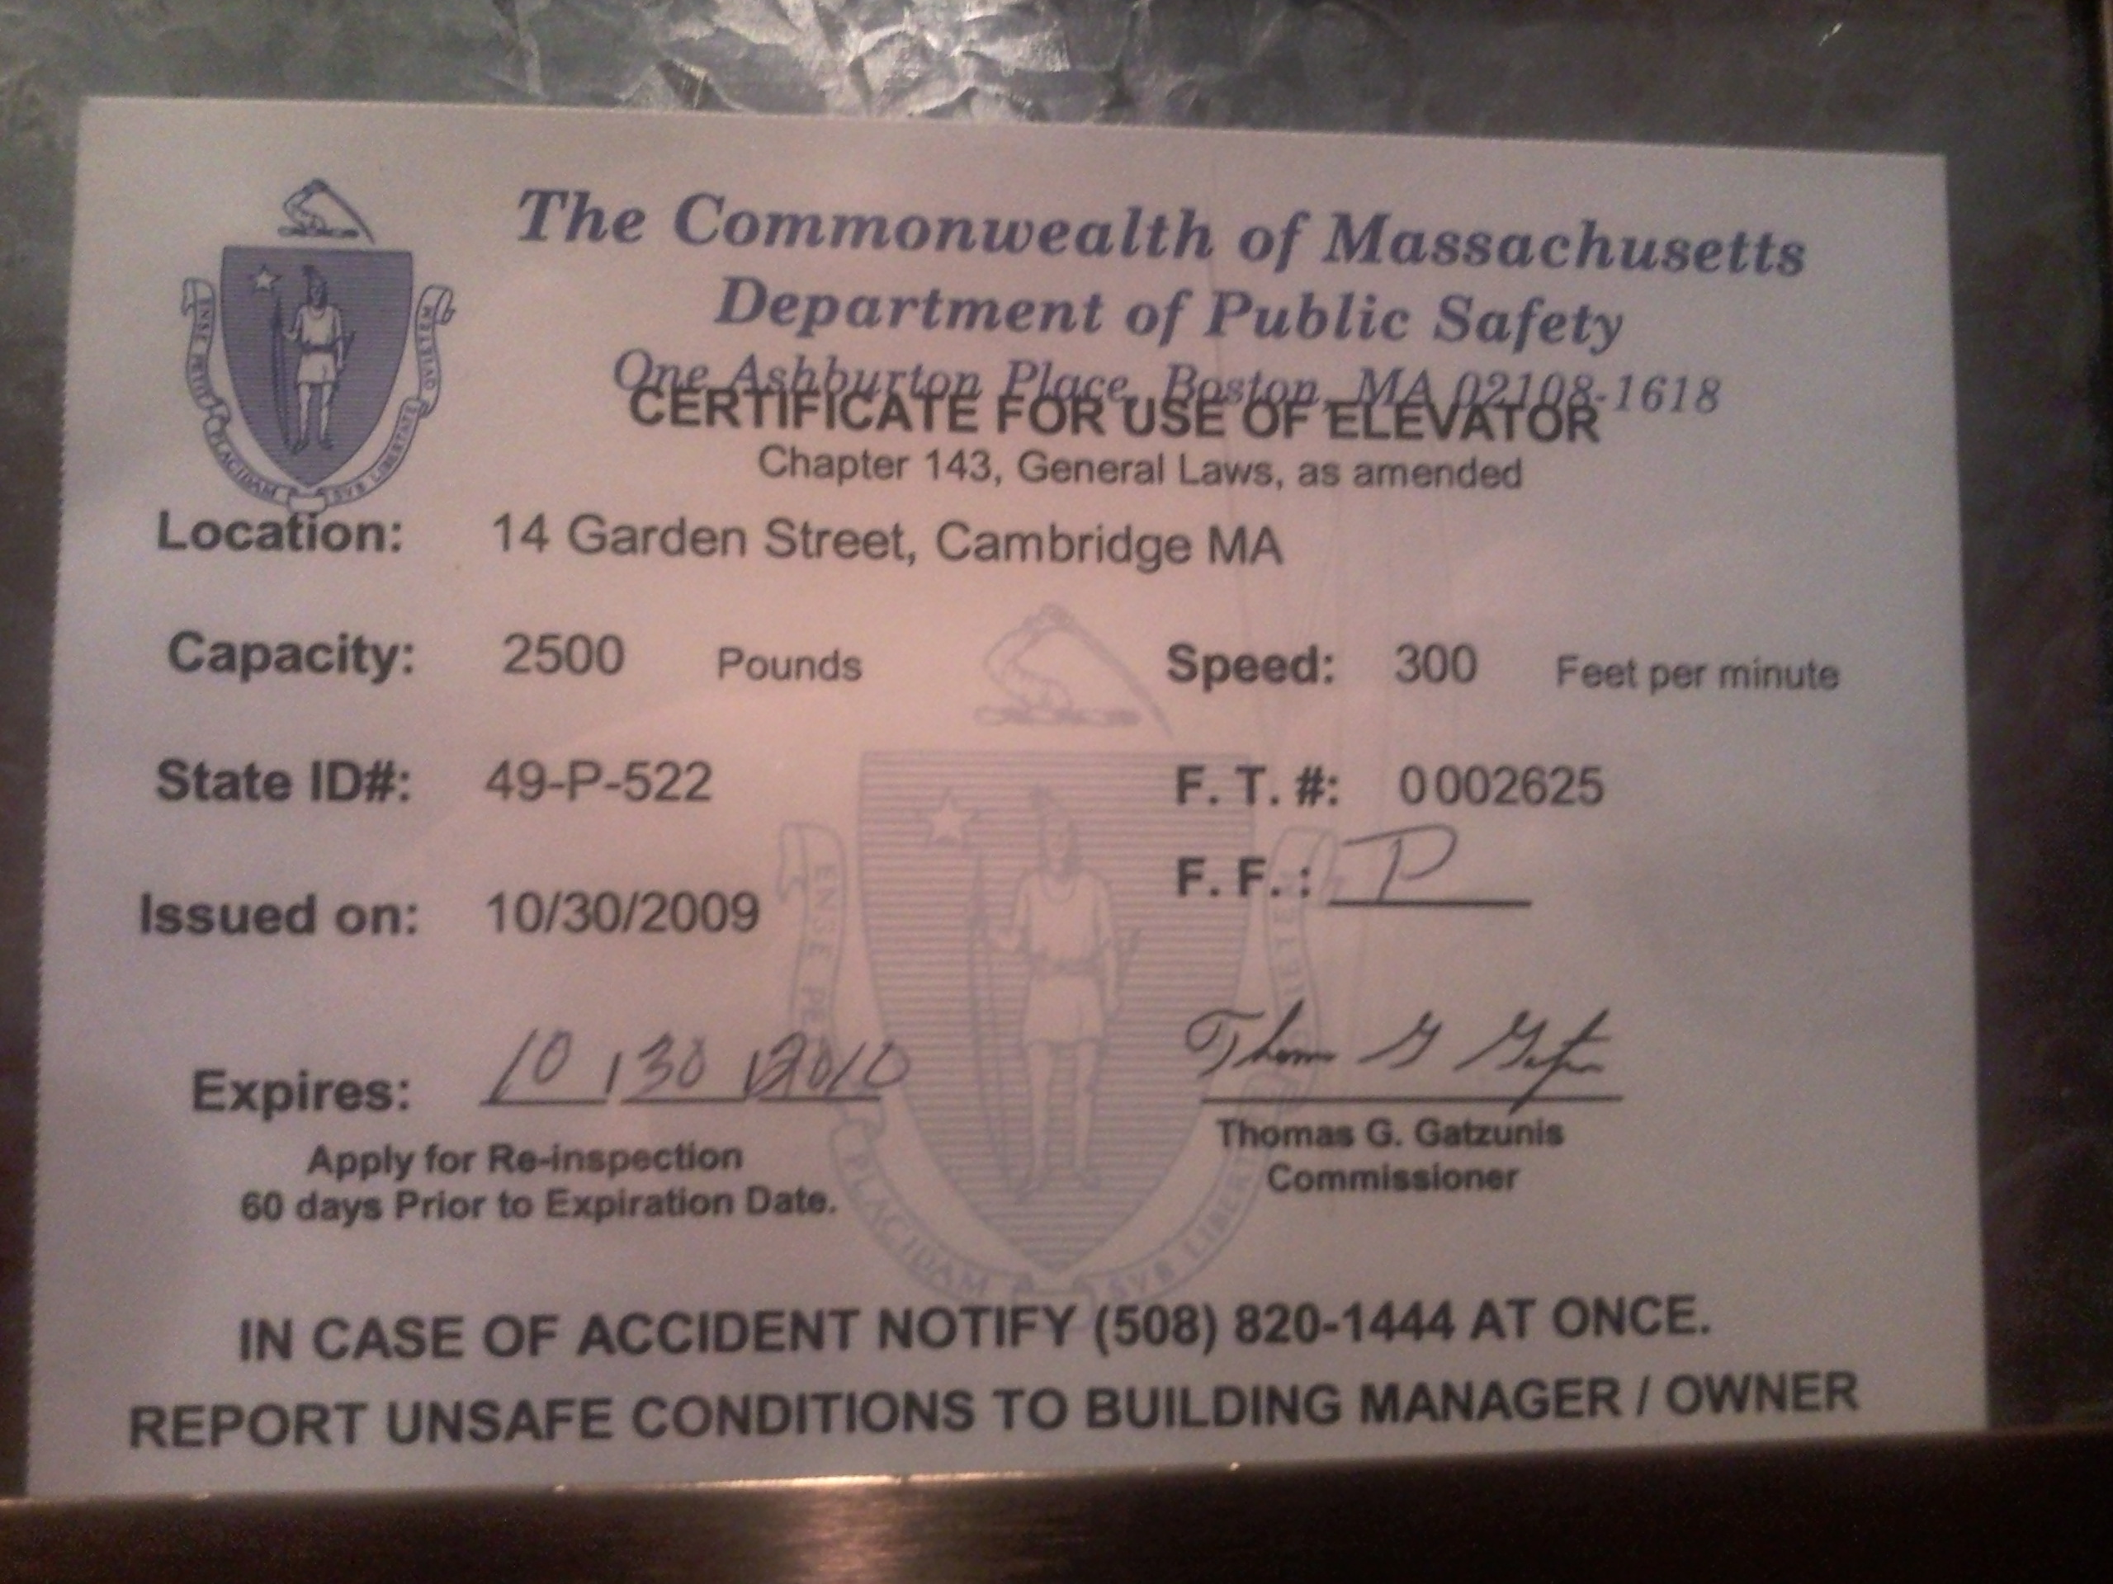
Sheraton Elevators – Which Door to Open?
Right elevator is 3x faster. Open that door. Here’s the data:
Lesson #3: Prepare to be humbled
Left Elevator
Right Elevator

Slide 9

Three Lessons to Remember from This Talk
Lesson #1: Ask what is the OEC? (Overall Evaluation Criterion) What are we optimizing for?
Lesson #2: Get the Data
Lesson #3: Prepare to be humbled
In many scenarios getting the data is hard
On the web, it’s easy – we can run controlled experiments
We can get the data, and it trumps our intuition

Slide 10

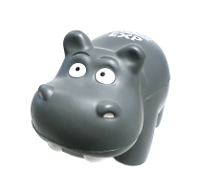
Amazon Shopping Cart Recommendations
Add an item to your shopping cart at a website
Most sites show the cart
At Amazon, Greg Linden had the idea of showing recommendations based on cart items
Evaluation
Pro: cross-sell more items (increase average basket size)
Con: distract people from checking out (reduce conversion)
HiPPO (Highest Paid Person’s Opinion) was: stop the project
Simple experiment was run, wildly successful, and the rest is history
From Greg Linden’s Blog: http://glinden.blogspot.com/2006/04/early-amazon-shopping-cart.html

Slide 11
Agenda for Rest of Talk
Controlled Experiments in one slide
Examples: you’re the decision maker
Cultural evolution: hubris, insight through measurement, Semmelweis reflex, fundamental understanding (Erik Brynjolfsson presented 4 stages: measurement, experiment, share, replicate; this model starts earlier and ends later.)
Quick overview of pros/cons of controlled experiments
Technical papers, more examples, the detailed statistics, tutorials are all at http://exp-platform.com (URL printed on the HiPPOs)

Slide 12
Controlled Experiments in One Slide
Concept is trivial
Randomly split traffic between two (or more) versions
A (Control)
B (Treatment)
Collect metrics of interest
Analyze
Must run statistical tests to confirm differences are not due to chance
Best scientific way to prove causality, i.e., the changes in metrics are caused by changes introduced in the treatment(s)

Slide 13
Examples
Three experiments that ran at Microsoft
All had enough users for statistical validity
Game: see how many you get right
Everyone please stand up
Three choices are:
A wins (the difference is statistically significant)
A and B are approximately the same (no stat sig diff)
B wins
If you guess randomly
1/3 left standing after first question
1/9 after the second question

Slide 14
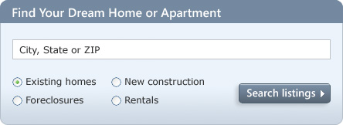
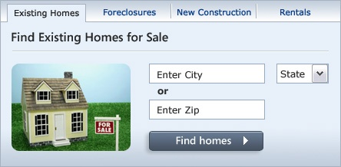
MSN Real Estate
“Find a house” widget variations
Overall Evaluation Criterion(OEC): Revenue to Microsoft generated every time a user clicks search/find button
A
B
Raise your right hand if you think A Wins
Raise your left hand if you think B Wins
Don’t raise your hand if you think they’re about the same

Slide 15
MSN Real Estate
If you did not raise a hand, please sit down
If you raised your left hand, please sit down
A was 8.5% better
Since this is the #1 monetization, it effectively raised revenues significantly
Actual experiment had 6 variants. If you’re going to experiment, try more variants, especially if they’re easy to implement

Slide 16


MSN Home Page Search Box
OEC: Clickthrough rate for Search box and popular searches
A
B
Differences: A has taller search box (overall size is the same), has magnifying glass icon, “popular searches”
B has big search button
Raise your right hand if you think A Wins
Raise your left hand if you think B Wins
Don’t raise your hand if they are the about the same

Slide 17
Search Box
If you raised any hand, please sit down
Insight
Stop debating, it’s easier to get the data

Slide 18
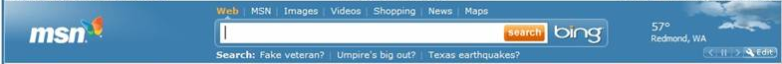

MSN US Home Page: Search Box
A later test showed that changing the magnifying glass to an actionable word (search, go, explore) was highly beneficial.
This:
is better than

Slide 19
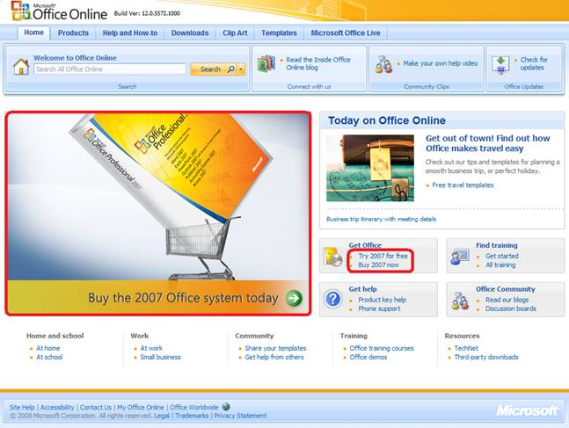
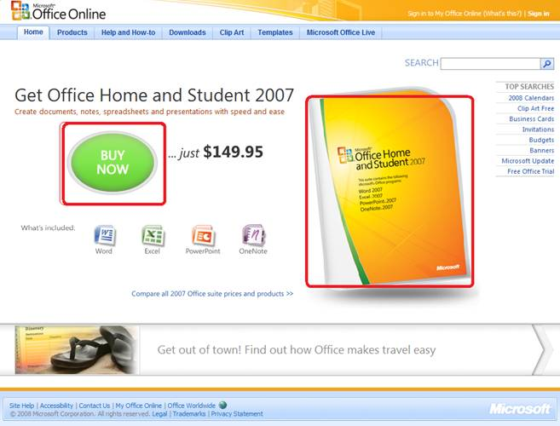
Office Online
OEC: Clicks on revenue generating links (red below)
A
B
Raise your right hand if you think A Wins
Raise your left hand if you think B Wins
Don’t raise your hand if they are the about the same

Slide 20
Office Online
If you did not raise a hand, please sit down
If you raised your left hand, please sit down
B was 64% worse
What % of the audience is still standing?
Humbling!
Remember lessons #2 and #3: get the data and prepare to be humbled

Slide 21
Twyman’s Law
Any statistic that appears interesting is almost certainly a mistake
If something is “amazing,” find the flaw!
Examples
If you have a mandatory birth date field and people think it’s unnecessary, you’ll find lots of 11/11/11 or 01/01/01
If you have an optional drop down, do not default to the first alphabetical entry, or you’ll have lots jobs = Astronaut
The previous Office example assumes click maps to revenue. Seemed reasonable, but when the results look so extreme, find the flaw (conversion rate is not the same; see why?)
Notes:
One has the price. Sends more qualified buyers

Slide 22
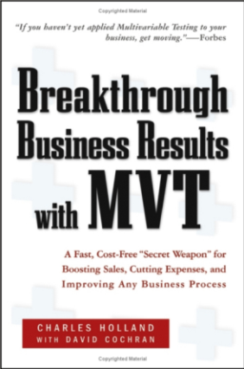
Hard to Assess the Value of Ideas: Data Trumps Intuition
QualPro tested 150,000 ideas over 22 years
75 percent of important business decisions and business improvement ideas either have no impact on performance or actually hurt performance…
At Amazon, half of the experiments failed to show improvement
Based on experiments with ExP at Microsoft
1/3 of ideas were positive ideas and statistically significant
1/3 of ideas were flat: no statistically significant difference
1/3 of ideas were negative and statistically significant
Our intuition is poor: 2/3rd of ideas do not improve the metric(s) they were designed to improve. Humbling!
Notes:
there is no correlation between what people in the organization think will work and what actually does work

Slide 23
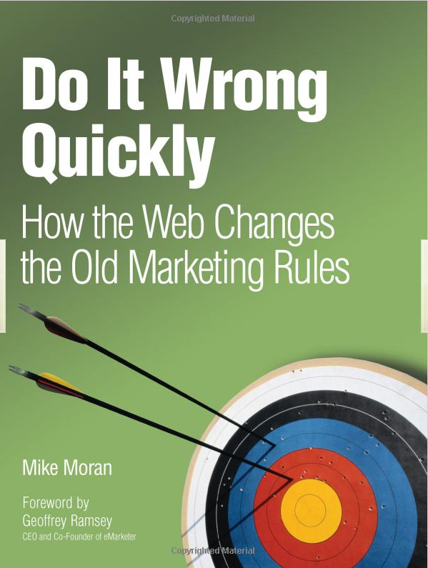
Key Lessons
Avoid the temptation to try and build optimal features through extensive planning without early testing of ideas
Experiment often
To have a great idea, have a lot of them -- Thomas Edison
If you have to kiss a lot of frogs to find a prince, find more frogs and kiss them faster and faster -- Mike Moran, Do it Wrong Quickly
Try radical ideas. You may be surprised
Doubly true if it’s cheap to implement (e.g., shopping cart recommendations)
If you're not prepared to be wrong, you'll never come up with anything original – Sir Ken Robinson, TED 2006

Slide 24
The OEC
If you remember one thing from this talk, remember this point
OEC = Overall Evaluation Criterion
Agree early on what you are optimizing
Getting agreement on the OEC in the org is a huge step forward
Suggestion: optimize for customer lifetime value, not immediate short-term revenue
Criterion could be weighted sum of factors, such as
Time on site (per time period, say week or month)
Visit frequency
Report many other metrics for diagnostics, i.e., to understand the why the OEC changed and raise new hypotheses

Slide 25
Agenda
Controlled Experiments in one slide
Examples: you’re the decision maker
Cultural evolution: hubris, insight through measurement, Semmelweis reflex, fundamental understanding
Quick overview of pros/cons of controlled experiments

Slide 26
The Cultural Challenge
It is difficult to get a man to understand something when his salary depends upon his not understanding it. -- Upton Sinclair
Why people/orgs avoid controlled experiments
Some believe it threatens their job as decision makers
At Microsoft, program managers select the next set of features to develop. Proposing several alternatives and admitting you don’t know which is best is hard
Editors and designers get paid to select a great design
Failures of ideas may hurt image and professional standing. It’s easier to declare success when the feature launches
We’ve heard: “we know what to do. It’s in our DNA,” and “why don’t we just do the right thing?”

Slide 27
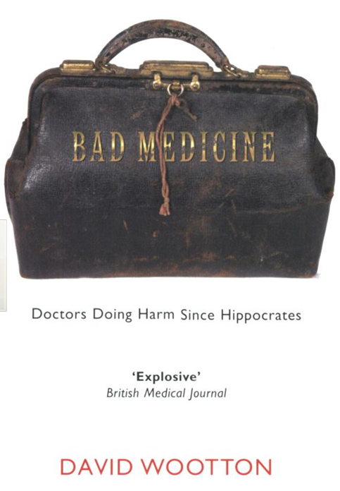
Cultural Stage 1: Hubris
The org goes through stages in its cultural evolution
Stage 1: we know what to do and we’re sure of it
True story from 1849
John Snow claimed that Cholera was caused by polluted water
A landlord dismissed his tenants’ complaints that their water stank
Even when Cholera was frequent among the tenants
One day he drank a glass of his tenants’ water to show there was nothing wrong with it
He died three days later
That’s hubris. Even if we’re sure of our ideas, evaluate them
Controlled experiments are a powerful tool to evaluate ideas

Slide 28
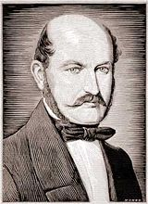
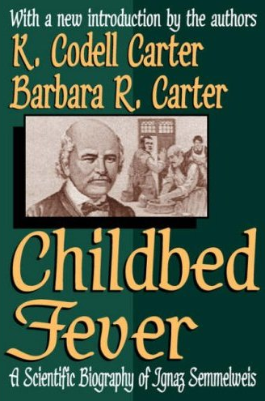

Semmelweis
Cultural Stage 2: Insight through Measurement and Control
Semmelweis worked at Vienna’s General Hospital, an important teaching/research hospital, in the 1830s-40s
In 19th-century Europe, childbed fever killed more than a million women
Measurement: the mortality rate for women giving birth was
15% in his ward, staffed by doctors and students
2% in the ward at the hospital, attended by midwives
Notes:
Collecting stats is the first phase – instrument, measure

Slide 29
Semmelweis
Cultural Stage 2: Insight through Measurement and Control
He tries to control all differences
Birthing positions, ventilation, diet, even the way laundry was done
He was away for 4 months and death rate fell significantly when he was away. Could it be related to him?
Insight:
Doctors were performing autopsies each morning on cadavers
Conjecture: particles (called germs today) were being transmitted to healthy patients on the hands of the physicians
He experiments with cleansing agents
Chlorine and lime was effective: death rate fell from 18% to 1%
Notes:
Collecting stats is the first phase – instrument, measure

Slide 30
Cultural Stage 3: Semmelweis Reflex
Success? No! Disbelief. Where/what are these particles?
Semmelweis was dropped from his post at the hospital
He goes to Hungary and reduced mortality rate in obstetrics to 0.85%
His student published a paper about the success. The editor wrote
We believe that this chlorine-washing theory has long outlived its usefulness… It is time we are no longer to be deceived by this theory
In 1865, he suffered a nervous breakdown and was beaten at a mental hospital, where he died
Semmelweis Reflex is a reflex-like rejection of new knowledge because it contradicts entrenched norms, beliefs or paradigms
Only in 1800s? No! A 2005 study: inadequate hand washing is one of the prime contributors to the 2 million health-care-associated infections and 90,000 related deaths annually in the United States

Slide 31
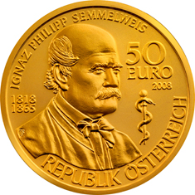
Cultural Stage 4: Fundamental Understanding
In 1879, Louis Pasteur showed the presence of Streptococcus in the blood of women with child fever
2008, 143 years after he died, there is a 50 Euro coin commemorating Semmelweis

Slide 32
Summary: Evolve the Culture
Hubris
Measure and Control
Accept Results avoid Semmelweis Reflex
Fundamental Understanding
In many areas we’re in the 1800s in terms of our understanding, so controlled experiments can help
First in doing the right thing, even if we don’t understand the fundamentals
Then developing the underlying fundamental theories

Slide 33
Agenda
Controlled Experiments in one slide
Examples: you’re the decision maker
Cultural evolution: hubris, insight through measurement, Semmelweis reflex, fundamental understanding
Quick overview of pros/cons of controlled experiments

Slide 34
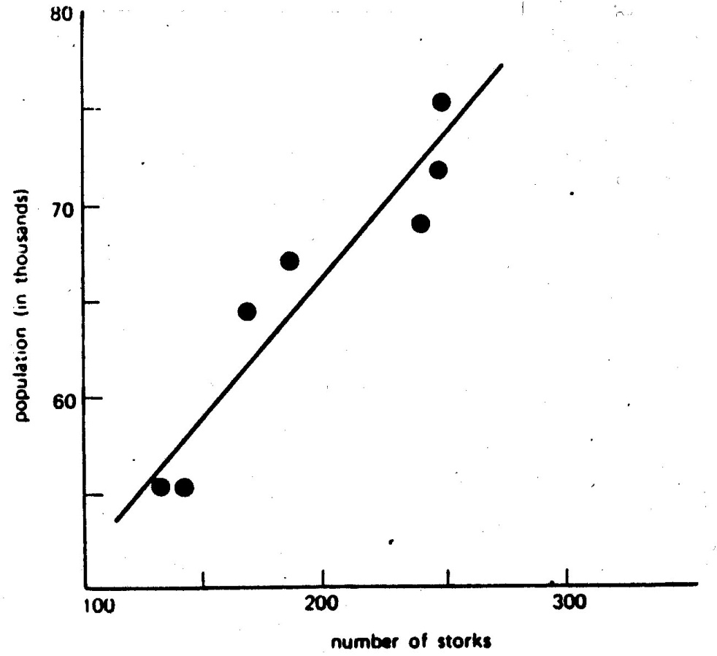
Typical Discovery
With data mining, we find patterns, but most are correlational, providing hypotheses for possible causes
Here is one a real example of two highly correlated variables

Slide 35
Correlations are not Necessarily Causal
Real Data for the city of Oldenburg, Germany
X-axis: stork population
Y-axis: human population
What your mother told you about babies and storks when you were three is still not right, despite the strong correlational “evidence”
Ornitholigische Monatsberichte 1936;44(2)

Slide 36
Correlation: Example 2
True statement (but not well known):
Palm size correlates with your life expectancy
The larger your palm, the less you will live, on average.
Try it out - look at your neighbors and you’ll see who is expected to live longer
But…don’t try to bandage your hands
Women have smaller palms and live 6 years longer on average

Slide 37
Advantages of Controlled Experiments
Controlled experiments test for causal relationships, not simply correlations
When the variants run concurrently, only two things could explain a change in metrics:
The “feature(s)” (A vs. B)
Random chance
Everything else happening affects both the variants
For #2, we conduct statistical tests for significance
The gold standard in science and the only way to prove efficacy of drugs in FDA drug tests

Slide 38
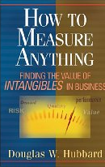
Issues with Controlled Experiments (1 of 2)
If you don't know where you are going, any road will take you there
—Lewis Carroll
Scope: Experimentation is not applicable everywhere
Necessary ingredients for experimentation to be useful detailed in paper at http://exp-platform.com/expMicrosoft.aspx
Sweet spot: websites and services that practice agile development
Org has to agree on OEC (Overall Evaluation Criterion)
This is hard, but it provides a clear direction and alignment
Some people claim their goals are “soft” or “intangible” and cannot be quantified. Give them Hubbard’s How to Measure Anything
Quantitative metrics, not always explanations of “why”
A treatment may lose because page-load time is slower. At Amazon, we slowed pages by 100-250msec and lost 1% of revenue
A treatment may have JavaScript that fails on certain browsers, causing users to abandon

Slide 39
Issues with Controlled Experiments (2 of 2)
Primacy/novelty effect
Changing navigation in a website may degrade the customer experience (temporarily), even if the new navigation is better
Evaluation may need to focus on new users, or run for a long period
Consistency/contamination
On the web, assignment is usually cookie-based, but people may use multiple computers, erase cookies, etc. Typically a small issue
Launch events / media announcements sometimes preclude controlled experiments
The journalists need to be shown the “new” version
Notes:
Good example of primacy: Office 2007 vs. Office 2003

Slide 40
Best Practice: A/A Test
Run A/A tests
Run an experiment where the Treatment and Control variants are coded identically and validate the following:
Are users split according to the planned percentages?
Is the data collected matching the system of record?
Are the results showing non-significant results 95% of the time?
This is a powerful technique for finding bugs and other integration issues before teams try to make data-driven decisions
Generating some numbers is easy
Getting correct numbers you trust is much harder!

Slide 41
Best Practice: Ramp-up
Ramp-up
Start an experiment at 0.1%
Do some simple analyses to make sure no egregious problems can be detected
Ramp-up to a larger percentage, and repeat until 50%
Big differences are easy to detect because the min sample size is quadratic in the effect we want to detect
Detecting 10% difference requires a small sample and serious problems can be detected during ramp-up
Detecting 0.1% requires a population 100^2 = 10,000 times bigger
Abort the experiment if treatment is significantly worse on OEC or other key metrics (e.g., time to generate page)

Slide 42
Best Practice: Run Experiments at 50/50%
Novice experimenters run 1% experiments
To detect an effect, you need to expose a certain number of users to the treatment (based on power calculations)
Fastest way to achieve that exposure is to run equal-probability variants (e.g., 50/50% for A/B)
Rare exception: biggest sites in the world.
On the MSN US home page, we sample 10% of traffic
If you perceive risk, don’t start an experiment at 50/50% from the beginning: Ramp-up over a short period

Slide 43
Summary
The less data, the stronger the opinions
Empower the HiPPO with data-driven decisions
Hippos kill more humans than any other (non-human) mammal (really)
OEC: make sure the org agrees what you are optimizing (long term lifetime value)
It is hard to assess the value of ideas
Listen to your customers – Get the data
Prepare to be humbled: data trumps intuition
Compute the statistics carefully
Getting a number is easy. Getting a number you should trust is harder
Experiment often
Triple your experiment rate and you triple your success (and failure) rate. Fail fast & often in order to succeed
Accelerate innovation by lowering the cost of experimenting

Slide 44

Shameless Plug
ExP is used at multiple properties at Microsoft, some of the largest in the world
If you love data, we have lots of it
If you like challenges, we have lots of them
We have full-time openings
We have 7 interns this summer We can take interns during the year (e.g., one quarter)
See http://exp-platform.com
E-mail ronnyk@ you know what

